Slide 1

WELCOME

Slide 2
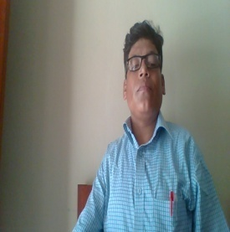
IDENTITY OF TEACHER
Md. Abu Abdur Rahman Siddiquee
(M. A, B. Ed)
Senior Assistant Teacher (English)
Jagarani M. L Girls’ High School
Newashi, Nageswari, Kurigram.
E-mail: siddiquee1211@gmail.com
Contact No. 01743943113

Slide 3


IDENTITY OF LESSON
Subject: English 2nd paper
Subject Code: 108
Class : 8/9
Present Ss:----
Total Ss:----
Duration: 50 Minutes
Date:--/--/20--

Slide 4
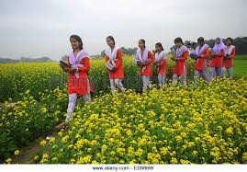

Look at the sentences
We go to school regularly.
Don’t we go to school regularly?
He doesn’t read the newspaper.
Does he read the newspaper?
What kind of change have you followed?

Slide 5


Today’s Topic is -
Transformation of sentences
Assertive to Interrogative

Slide 6

At the end of the lesson, students
will be able to …
indentify assertive and interrogative sentences.
transform the sentences according to rules.

Slide 7
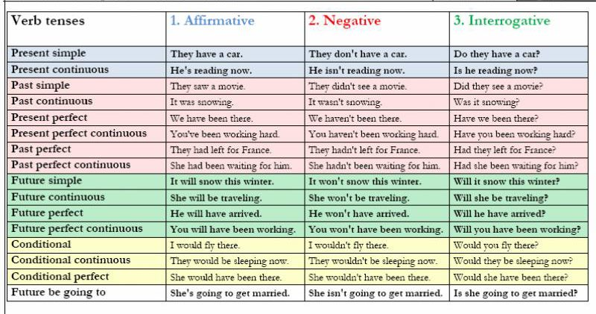

Slide 8


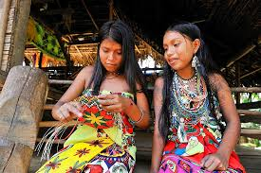
Transformation of Sentences
Assertive to interrogative
Rule 1:
অর্থের পরিবর্তন না করে সাহায্যকারী verb যুক্ত Assertive sentence কে interrogative এ রুপান্তর করার সময় sentence টি যদি affirmative হয় তাহলে – Auxiliary verb + n’t + subject + বাকী + ?
Note- assertive এ will, can, shall, am থাকলে interrogative এ রুপান্তর করার সময় won’t, can’t, shan’t, ain’t হয়.
Assertive – He is in the school.
Interrogative – Isn’t he in the school?
Assertive – You can do the work.
Interrogative – Can’t you do the work?

Slide 9
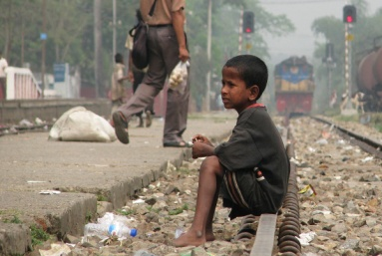
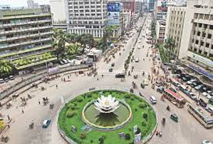
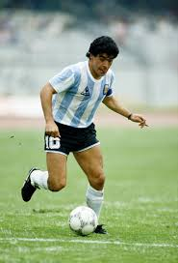
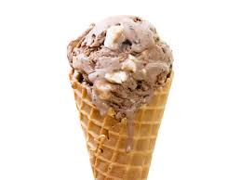
Rule 2:
Auxiliary verb যুক্ত negative অর্থবোধক Assertive sentence কে interrogative এ রুপান্তর করার সময় negative উঠে যায়। এবং সাহায্যকারী verb প্রথমে বসে। শেষে প্রশ্নবোধক চিহ্ন বসে।
Assertive – He is not in the school.
Interrogative – Is he in the school?
Assertive – I shall not go to Dhaka tomorrow.
Interrogative – Shall I go to Dhaka tomorrow?
Rule 3:
Auxiliary verb বিহীন Assertive sentence interrogative এ রুপান্তর করার সময় – Subject and tense অনুযায়ী don’t/ didn’t/ doesn’t বসে + subject + v1 + verb এর পরের অংশ +?
Assertive – He played good football.
Interrogative – Didn’t he play good football?
Assertive – He likes ice-cream.
Interrogative – Doesn’t he like ice-cream?

Slide 10
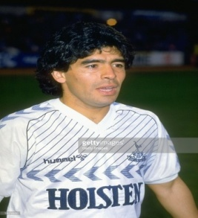
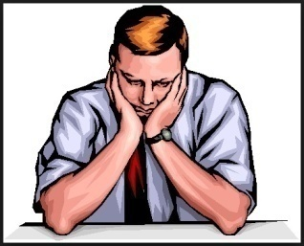

Rule 4:
Assertive sentence এ never থাকলে ever হয় এবং nothing থাকলে anything হয়। auxiliary verb না থাকলে Subject and tense অনুযায়ী প্রথমে আনতে হয়। শেষে প্রশ্নবোধক চিহ্ন বসে।
Assertive – You never play football.
Interrogative - Do you ever play football?
Assertive – I have nothing to do.
Interrogative – Have I anything to do?
Note – Assertive sentence এর subject এ যদি nothing থাকে তাহলে nothing এর জায়গায় what বসে।
Assertive – Nothing can ruin him.
Interrogative – what can ruin him?

Slide 11




Rule 5:
Everybody/ everyone/all যুক্ত Assertive sentence কে interrogative এ রুপান্তর করার সময় Everybody/ everyone/all এর পরিবর্তে who বসে + Subject and tense অনুযায়ী don’t/ didn’t/ doesn’t বসে + v1 + verb এর পরের অংশ +?
Assertive – Everybody wants to be win.
Interrogative – Who doesn’t wish to be win?
Assertive – Everybody/All loves flowers.
Interrogative – Who doesn’t love flower?
Rule 6:
Nobody/none/no one interrogative এ রুপান্তর করার সময় –
Nobody/none/no one এর পরিবর্তে who বসে + বাকী অংশ + ?
Assertive – Nobody could ever count my love for you.
Interrogative – Who could ever count my love for you?
Assertive – No one can beat him.
Interrogative – Who can beat him?

Slide 12

Group Work
Transform the sentences into interrogative;
Tea grows in plenty in Bangladesh.
I can never forget you.
They do outing for the country.
Patriotism is a very noble virtue.
She passed her time in reading.
Everybody respects an honest man.
Nobody likes a liar.

Slide 13
Assertive | Interrogative
Affirmative sentence Smoking is a bad habit. | Negative-Interrogative Isn’t smoking a bad habit?
Negative sentence I didn’t go to school yesterday. | Affirmative-Interrogative Did I go to school yesterday?
Everybody/Everyone/All Everyone wishes to be happy. | Who + Negative-Interro Who doesn’t wish to be happy?
Every/All + Noun All men hate a liar. | Is there any + Noun +who + Negative Is there any man who does not hate a liar?
In the middle of a sentence ‘Nothing’ Sub-’Nothing’ He knows nothing about it. Nothing is impossible. | Anything What Does he know anything about it? What is impossible?

Slide 14
Assertive | Interrogative
Nobody/No one/None None can do this. Note: Negative word- Affirma Nobody- any body, No-any, None-anyone, never-ever, Not where-any where, nothing -anything | Who Negative word – Affirm Who can do this? Can anyone do this?
There+ is+ no /nobody /none There is no hope for me. | Who/what+Affir-Interro What is the hope for me?
It does not matter It does not matter, if we lose it. | What though What though if we lose it?

Slide 15
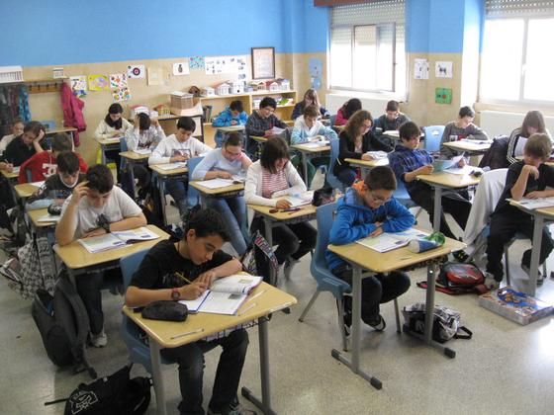
Individual Work
Transform the following sentences into interrogative sentences;
I found Razia writing a letter.
Everybody hates a liar.
He knows how to swim.
She was not very happy.
All men must die.
Everybody wishes to be happy.

Slide 16
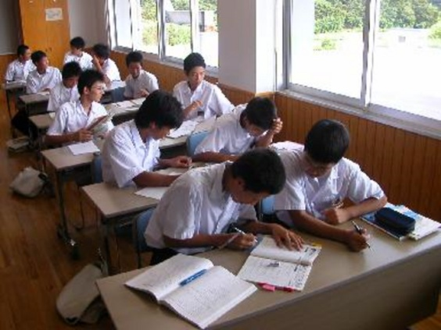
Pair Work
Transform the following sentences into interrogative sentences;
I can never forget you.
We are proud of our freedom fighters.
Nobody dislikes flower.
Time and tide wait for none.
My friend invited me to pay a visit to
Cox’s Bazar yesterday.

Slide 17

Change the sentences into Ass↔Int
Nobody respects him.
Bangladesh is a low lying country.
People of all ages like to watch TV.
A flower is a glowing gift of nature.
Who does not know him?
All love her .
Is there anybody who does not like flower?
Wasting time is harmful for them.

Slide 18


Work
Home
Transform the following sentences:
Everyone respects a truthful man. (Int)
They are playing cards. (Int)
Doesn’t ice float on water? (Ass)
Who doesn’t wish to be happy? (Ass)
Walking is a good exercise. (Int)
Who loves a liar? (Ass)
We ought to love our country. (Int)

Slide 19



